Slide 1
Capstone Presentation:
Crime Map
Chris Rudnew, Taylor McCubbing, Diego Padilla, Carlos Diaz
Under the Supervision of: Mohammed Elmorsy
http://162.246.156.84/

Slide 2
Meet the Team
http://162.246.156.84/
Chris Rudnew
Taylor McCubbing
Diego Padilla
Carlos Diaz
Under the Supervision of: Mohammed Elmorsy

Slide 3
Motivations
http://162.246.156.84/
Desire to learn new skills, and create something that we had little to no experience with
Web Development
No experience building or maintaining a website
Additionally, we had the desire to create something that we could continue developing and innovating, after our time at MacEwan was over
Something that could help society

Slide 4
Objectives
http://162.246.156.84/
Develop a website that has real world applications
Make the website concise and user friendly
Make the website more personal than the existing EPS website
What we wanted to create was a crime database with a more personal approach (i.e. the ability to mark suspicious activity at the time of occurrence, giving people the choice to avoid the marked area)
Provide real statistics of crime (Pie Chart and Bar Chart that change depending on the neighbourhood
This provides visualization of crime severity and intensity, in a statistical format
Make a map that can show the user more dangerous parts of Edmonton
Have an option where the user can report an incident in an area, letting the user have more control over what the map of Edmonton shows

Slide 5
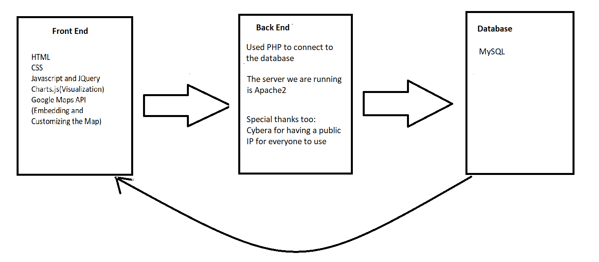
Project Components
http://162.246.156.84/

Slide 6
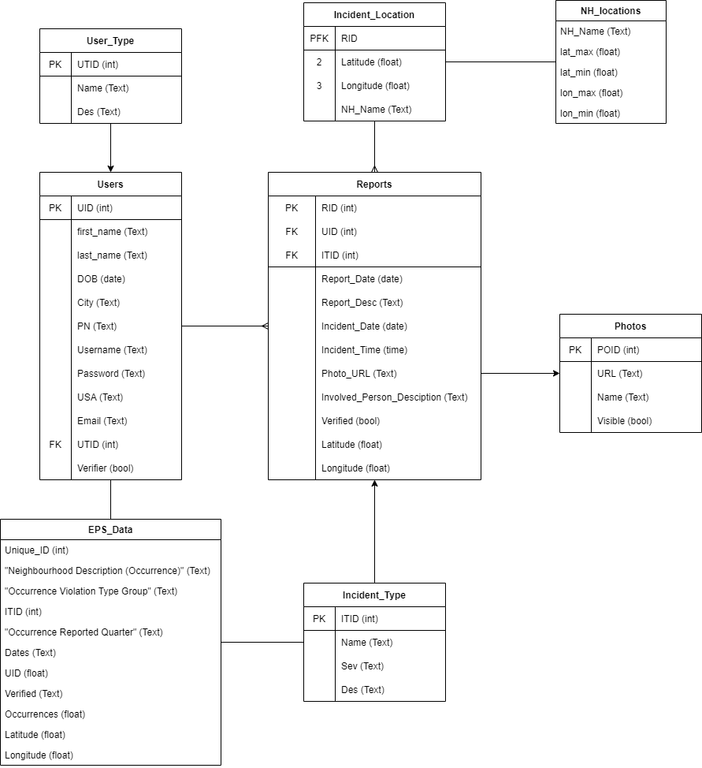
Database Design: ER Diagram
http://162.246.156.84/
Notes:
This is the ER Diagram we designed. Our main focus was to create a database that would allow a user register and create all the different reports depending on the incident type they were choosing. After we designed our database we started looking for a dataset that could fit.
In the Edmonton Police Website we found a dataset that went to up to 2019. We modified all the information from this dataset so it could be compatible with our DB and we added all the information to a modified dictionary which we called EPS_Data.

Slide 7
Dataset Used
http://162.246.156.84/
Dataset was posted by Open Analytics and made available through the edmonton police service website.
This dataset provided the type of crime, date, and the neighborhood the crime happened in for the years 2009 - 2019.
Created a script to turn the neighborhoods in GPS locations
Dataset can be found at : http://ace.edmonton.ca/projects/visualizations/edmontons-crime-stats/

Slide 8
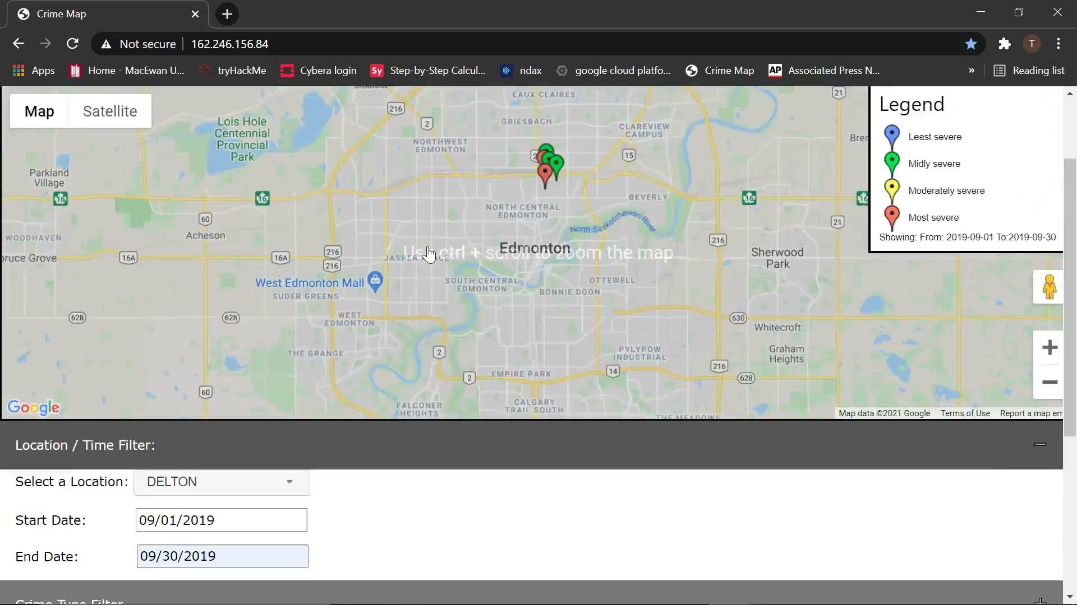
Demo
http://162.246.156.84/

Slide 9
Future Additions
http://162.246.156.84/
The Main Constraint: The lack of a personal domain
Make into a mobile application
Increase security measure
Add data mining functionality
Image processing
Notes:
Lack of personal domain: We only have a public IP provided by cybera, we do not have a common domain registered.
Create a mobile App: Since we have been completely testing on a web browser, the functionality is still there for mobile, but the UI is not completely adapted.
Increase sour website security: Since we are only using the sql default hashing function in order to protect the credentials of the users, we would like to expand and increase the security of our website using a more complex hashing function.
We want to implement an image processing function. Since one of the main features we wanted was for the users to be able to share a picture when they are reporting an incident, but sometimes we are not legally allowed to share picture to the public, it all depends on the content shown. That is why this function is supposed to check if that the photo submitted by the user can be shown on the website, if not we still save it in our DB but we will not be showing it. For now on the photos table we only have a boolean value that checks if a picture can be shown or not.
Also, for the late future, we want to have an image processing function, this is just a fancy way to say machine learning, were the system will search the photos the users upload and find similarities with them in order to filter the crime types that could match the report.

Slide 10
Questions?
http://162.246.156.84/

